Slide 1

EE4H, M.Sc 0407191
Computer Vision
Dr. Mike Spann
m.spann@bham.ac.uk
http://www.eee.bham.ac.uk/spannm

Slide 2
Introduction to image segmentation
The purpose of image segmentation is to partition an image into meaningful regions with respect to a particular application
The segmentation is based on measurements taken from the image and might be greylevel, colour, texture, depth or motion

Slide 3
Introduction to image segmentation
Usually image segmentation is an initial and vital step in a series of processes aimed at overall image understanding
Applications of image segmentation include
  Identifying objects in a scene for object-based measurements such as size and shape
  Identifying objects in a moving scene for object-based video compression (MPEG4)
  Identifying objects which are at different distances from a sensor using depth measurements from a laser range finder enabling path planning for a mobile robots
  Intro Video

Slide 4
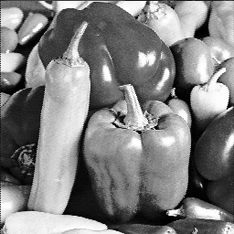
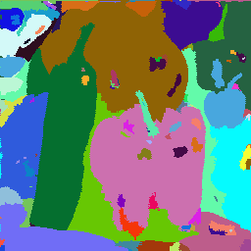
Introduction to image segmentation
Example 1
  Segmentation based on greyscale
  Very simple ‘model’ of greyscale leads to inaccuracies in object labelling

Slide 5
Introduction to image segmentation
Example 2
  Segmentation based on texture
  Enables object surfaces with varying patterns of grey to be segmented

Slide 6
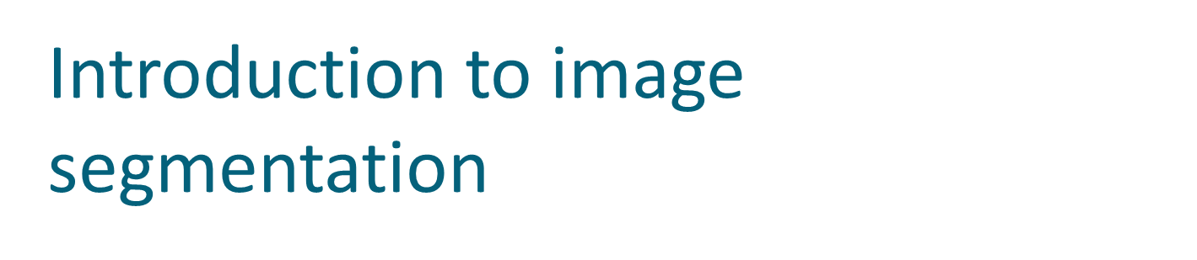
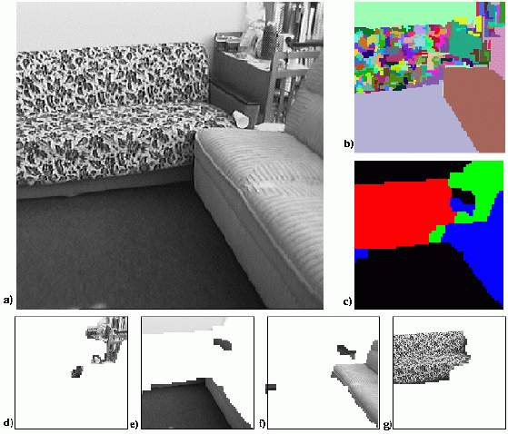

Slide 7
Introduction to image segmentation
Example 3
  Segmentation based on motion
  The main difficulty of motion segmentation is that an intermediate step is required to (either implicitly or explicitly) estimate an optical flow field
  The segmentation must be based on this estimate and not, in general, the true flow

Slide 8
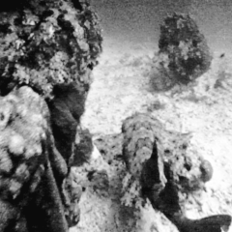
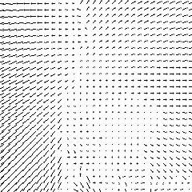
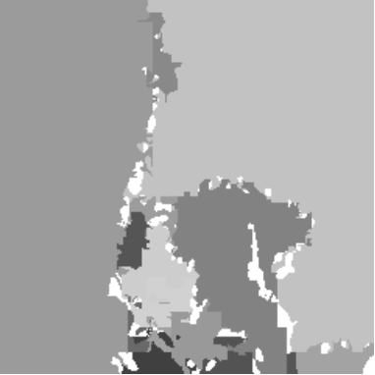

Slide 9
Introduction to image segmentation
Example 3
  Segmentation based on depth
  This example shows a range image, obtained with a laser range finder
  A segmentation based on the range (the object distance from the sensor) is useful in guiding mobile robots

Slide 10
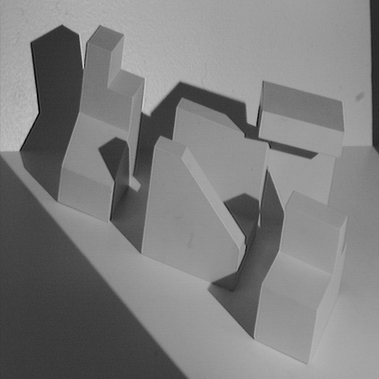
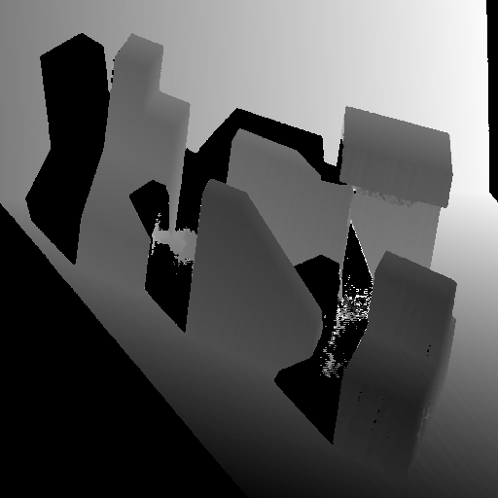
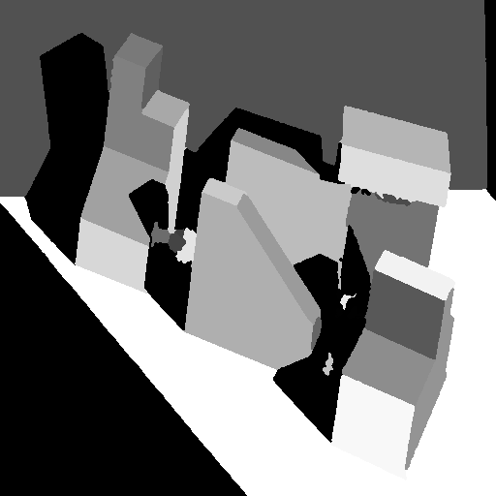
Range image
Original image
Segmented image

Slide 11
Greylevel histogram-based segmentation
We will look at two very simple image segmentation techniques that are based on the greylevel histogram of an image
  Thresholding
  Clustering
We will use a very simple object-background test image
  We will consider a zero, low and high noise image

Slide 12
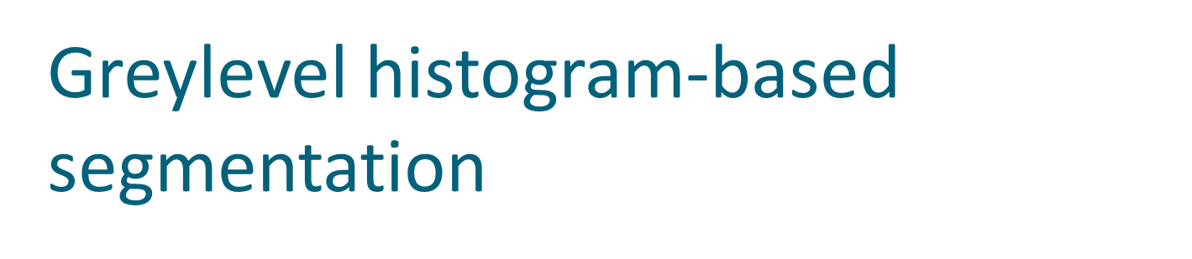

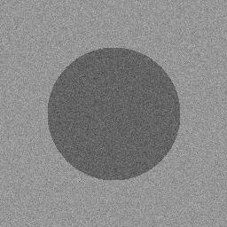
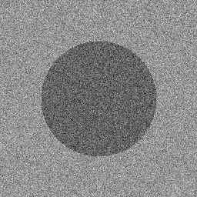
Noise free
Low noise
High noise

Slide 13
Greylevel histogram-based segmentation
How do we characterise low noise and high noise?
We can consider the histograms of our images
  For the noise free image, its simply two spikes at i=100, i=150
  For the low noise image, there are two clear peaks centred on i=100, i=150
  For the high noise image, there is a single peak – two greylevel populations corresponding to object and background have merged

Slide 14
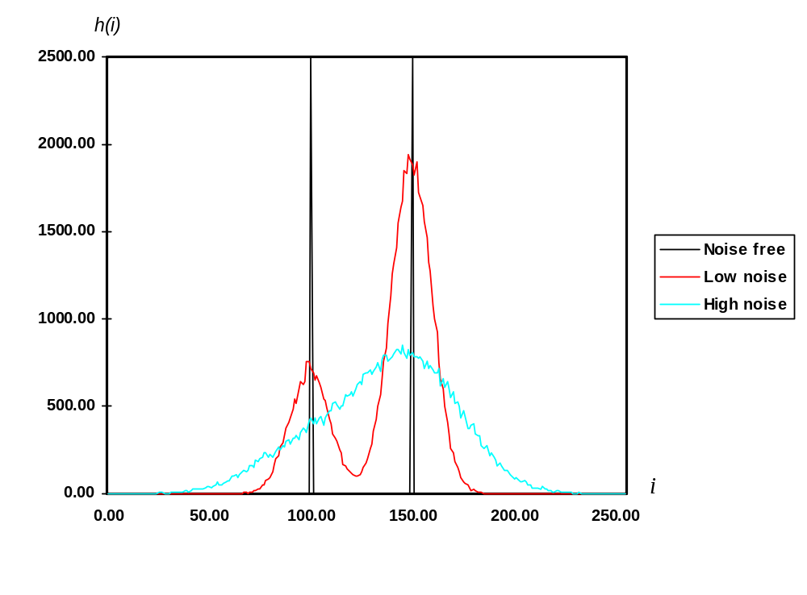

Slide 15
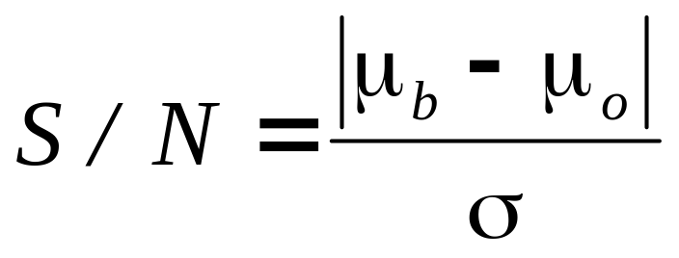
Greylevel histogram-based segmentation
We can define the input image signal-to-noise ratio in terms of the mean greylevel value of the object pixels and background pixels and the additive noise standard deviation

Slide 16
Greylevel histogram-based segmentation
For our test images :
  S/N (noise free) = ∞
  S/N (low noise) = 5
  S/N (high noise) = 2

Slide 17
Greylevel thresholding
We can easily understand segmentation based on thresholding by looking at the histogram of the low noise object/background image
  There is a clear ‘valley’ between to two peaks

Slide 18

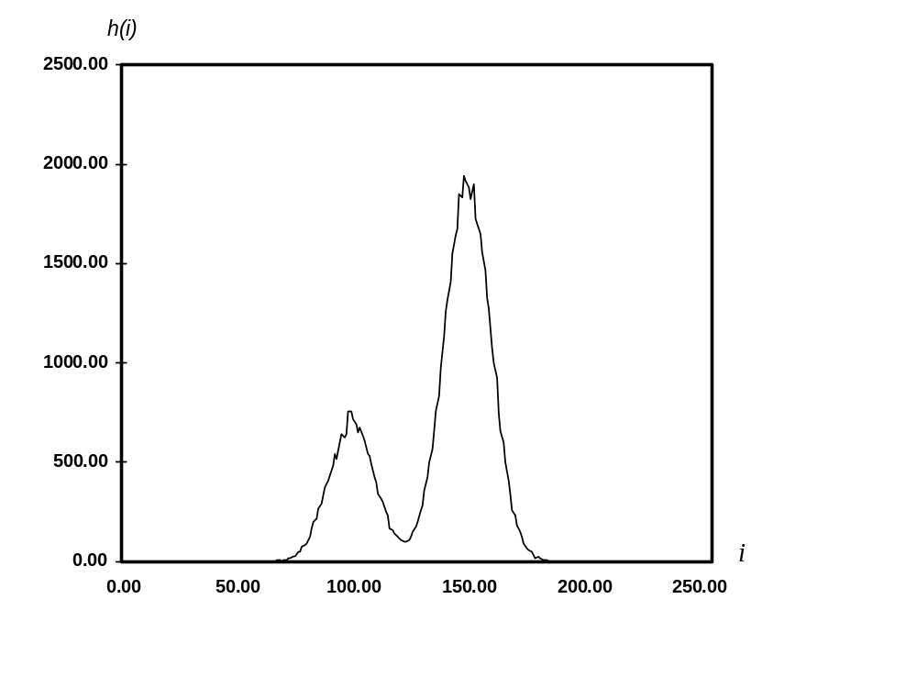
Background
Object
T

Slide 19
Greylevel thresholding
We can define the greylevel thresholding algorithm as follows:
  If the greylevel of pixel p <=T then pixel p is an object pixel
else
  Pixel p is a background pixel

Slide 20
Greylevel thresholding
This simple threshold test begs the obvious question how do we determine the threshold ?
Many approaches possible
  Interactive threshold
  Adaptive threshold
  Minimisation method

Slide 21
Greylevel thresholding
We will consider in detail a minimisation method for determining the threshold
  Minimisation of the within group variance
  Robot Vision, Haralick & Shapiro, volume 1, page 20

Slide 22
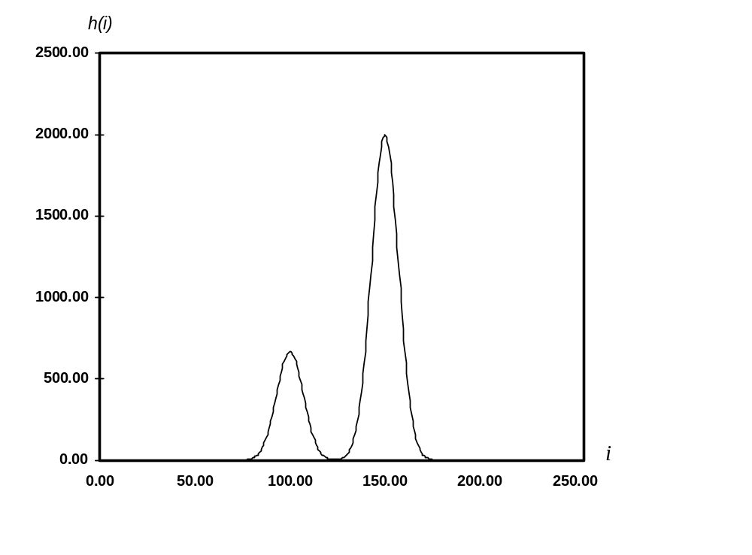
Greylevel thresholding
Idealized object/background image histogram
T

Slide 23
Greylevel thresholding
Any threshold separates the histogram into 2 groups with each group having its own statistics (mean, variance)
The homogeneity of each group is measured by the within group variance
The optimum threshold is that threshold which minimizes the within group variance thus maximizing the homogeneity of each group

Slide 24
Greylevel thresholding
Let group o (object) be those pixels with greylevel <=T
Let group b (background) be those pixels with greylevel >T
The prior probability of group o is p_{o}(T)
The prior probability of group b is p_{b}(T)

Slide 25
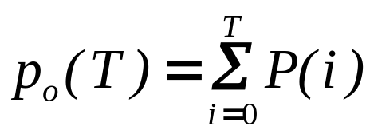
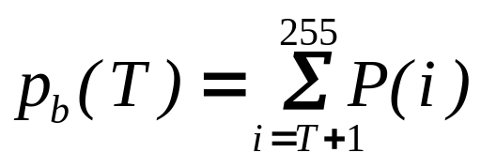
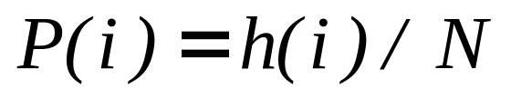
Greylevel thresholding
The following expressions can easily be derived for prior probabilities of object and background
where h(i) is the histogram of an N pixel image

Slide 26
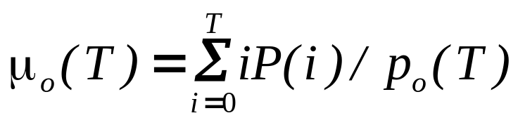
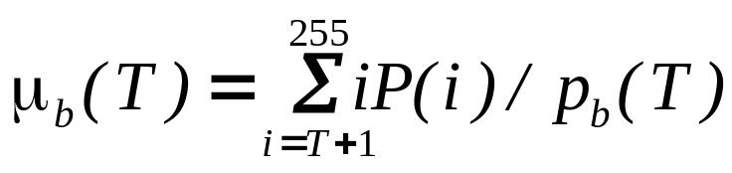
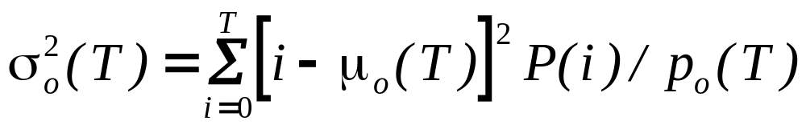
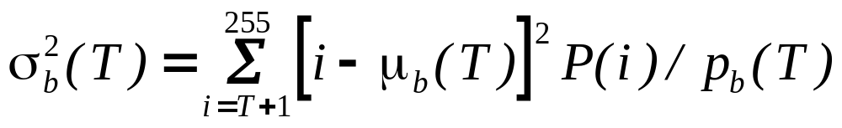
Greylevel thresholding
The mean and variance of each group are as follows :

Slide 27
Greylevel thresholding
The within group variance is defined as :
We determine the optimum T by minimizing this expression with respect to T
  Only requires 256 comparisons for and 8-bit greylevel image

Slide 28

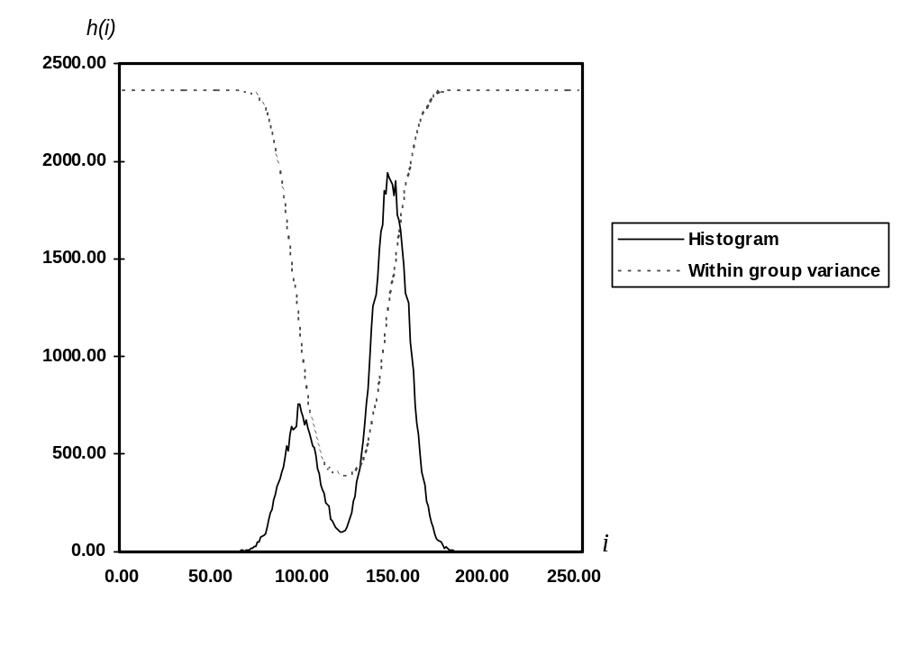

Slide 29
Greylevel thresholding
We can examine the performance of this algorithm on our low and high noise image
  For the low noise case, it gives an optimum threshold of T=124
  Almost exactly halfway between the object and background peaks
  We can apply this optimum threshold to both the low and high noise images

Slide 30
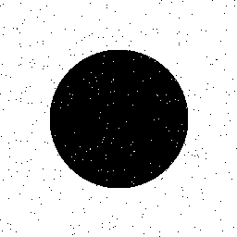
Low noise image
Thresholded at T=124

Slide 31
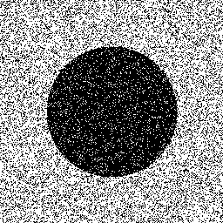
Low noise image
Thresholded at T=124

Slide 32
Greylevel thresholding
High level of pixel miss-classification noticeable
This is typical performance for thresholding
  The extent of pixel miss-classification is determined by the overlap between object and background histograms.

Slide 33
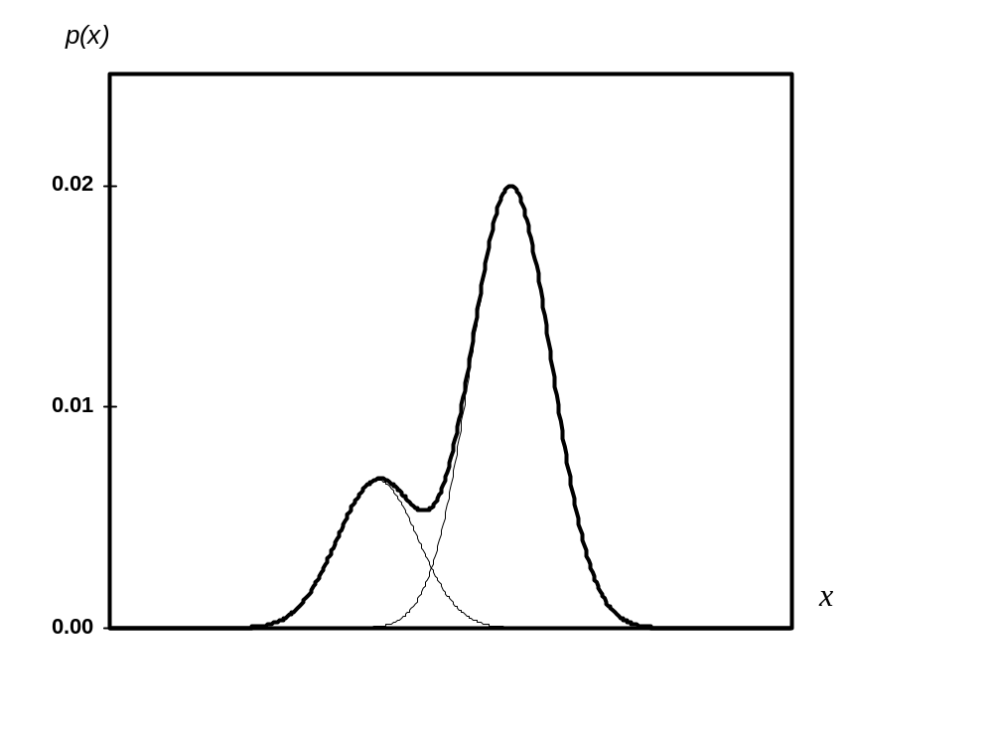



Background
Object

Slide 34
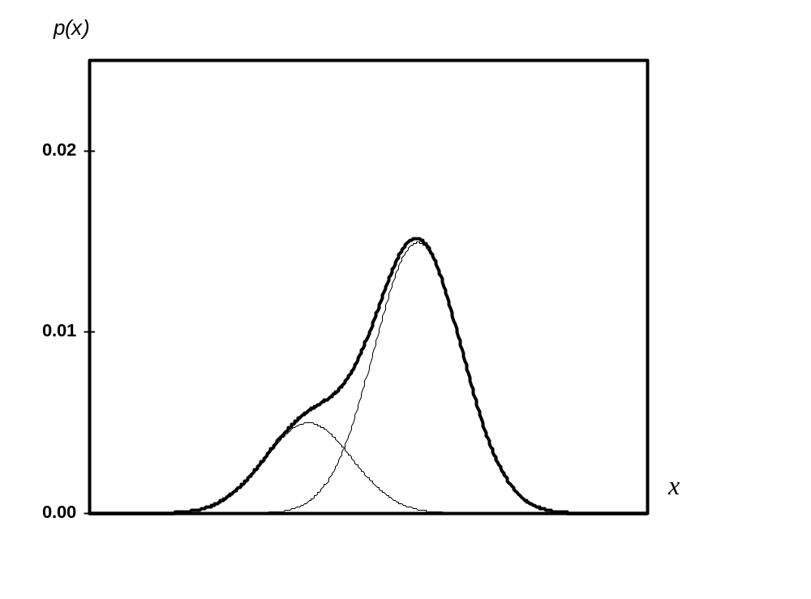
Background
Object

Slide 35
Greylevel thresholding
Easy to see that, in both cases, for any value of the threshold, object pixels will be miss-classified as background and vice versa
For greater histogram overlap, the pixel miss-classification is obviously greater
  We could even quantify the probability of error in terms of the mean and standard deviations of the object and background histograms

Slide 36
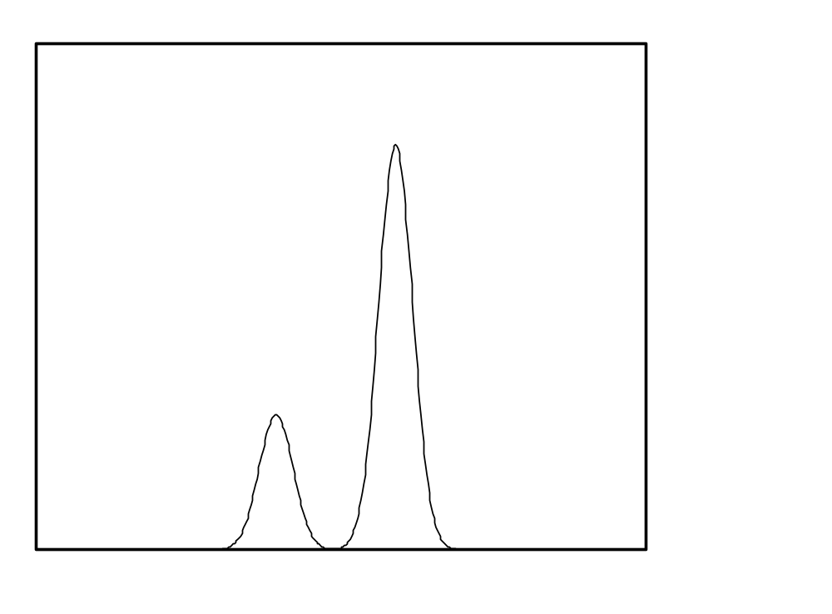


Greylevel clustering
Consider an idealized object/background histogram
Background
Object

Slide 37
Greylevel clustering
Clustering tries to separate the histogram into 2 groups
Defined by two cluster centres c₁ and c₂
  Greylevels classified according to the nearest cluster centre

Slide 38
Greylevel clustering
A nearest neighbour clustering algorithm allows us perform a greylevel segmentation using clustering
  A simple case of a more general and widely used K-means clustering
  A simple iterative algorithm which has known convergence properties

Slide 39
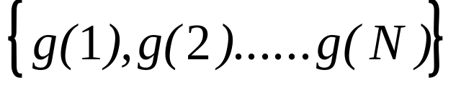
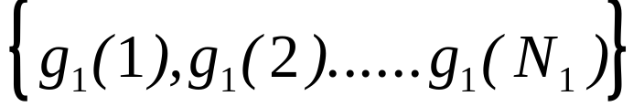

Greylevel clustering
Given a set of greylevels
We can partition this set into two groups

Slide 40
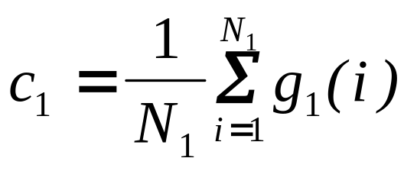
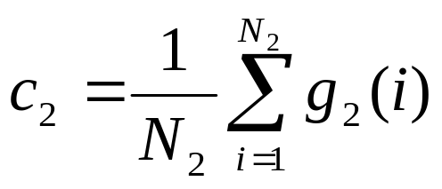
Greylevel clustering
Compute the local means of each group

Slide 41
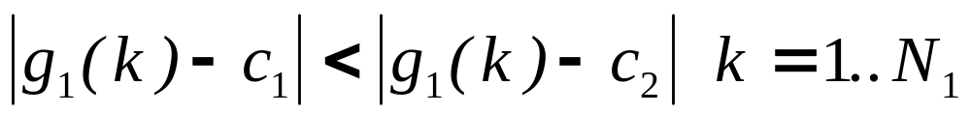
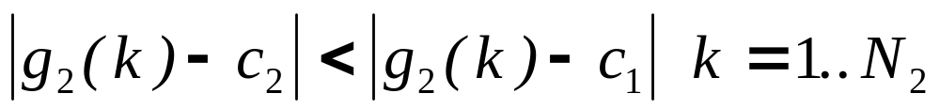
Greylevel clustering
Re-define the new groupings
In other words all grey levels in set 1 are nearer to cluster centre c₁ and all grey levels in set 2 are nearer to cluster centre c₂

Slide 42
Greylevel clustering
But, we have a chicken and egg situation
  The problem with the above definition is that each group mean is defined in terms of the partitions and vice versa
  The solution is to define an iterative algorithm and worry about the convergence of the algorithm later

Slide 43
Greylevel clustering
The iterative algorithm is as follows
Initialize the label of each pixel randomly
Repeat
c₁= mean of pixels assigned to object label
c₂= mean of pixels assigned to background label
Compute partition
Compute partition
Until none pixel labelling changes

Slide 44
Greylevel clustering
Two questions to answer
  Does this algorithm converge?
  If so, to what does it converge?
We can show that the algorithm is guaranteed to converge and also that it converges to a sensible result

Slide 45
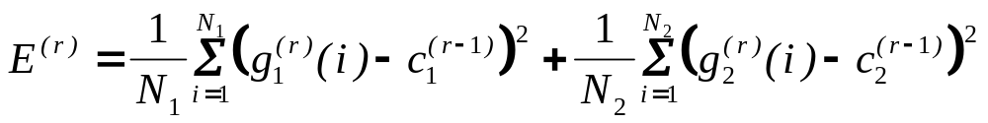
Greylevel clustering
Outline proof of algorithm convergence
  Define a ‘cost function’ at iteration r
  E^{(r)} >0

Slide 46
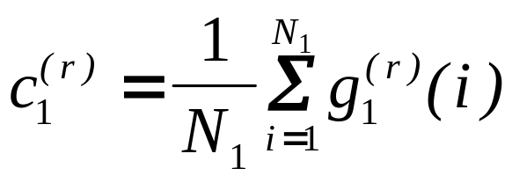
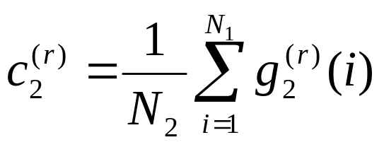
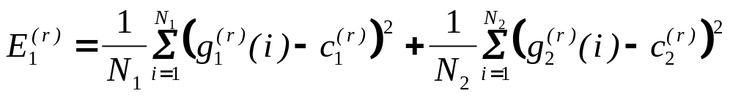
Greylevel clustering
Now update the cluster centres
Finally update the cost function

Slide 47
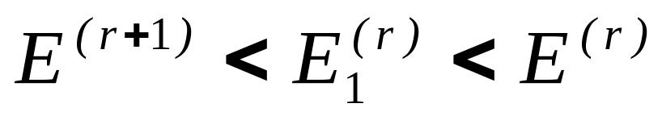
Greylevel clustering
Easy to show that
Since E^{(r)} >0, we conclude that the algorithm must converge
  but
What does the algorithm converge to?

Slide 48
Greylevel clustering
E₁ is simply the sum of the variances within each cluster which is minimised at convergence
  Gives sensible results for well separated clusters
  Similar performance to thresholding

Slide 49

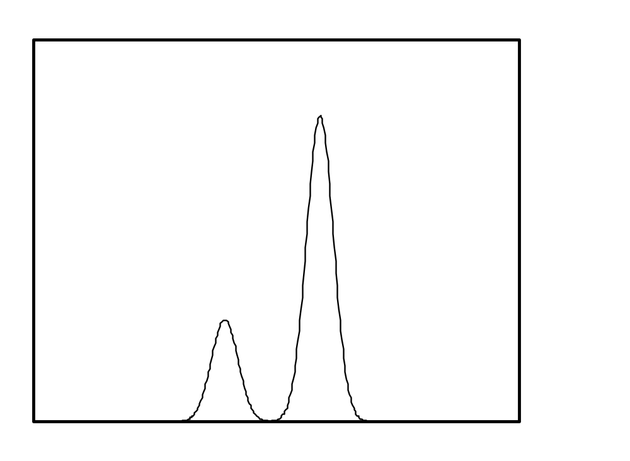




Slide 50
Relaxation labelling
All of the segmentation algorithms we have considered thus far have been based on the histogram of the image
  This ignores the greylevels of each pixels’ neighbours which will strongly influence the classification of each pixel
  Objects are usually represented by a spatially contiguous set of pixels

Slide 51
Relaxation labelling
The following is a trivial example of a likely pixel miss-classification
Object
Background

Slide 52
Relaxation labelling
Relaxation labelling is a fairly general technique in computer vision which is able to incorporate constraints (such as spatial continuity) into image labelling problems
We will look at a simple application to greylevel image segmentation
It could be extended to colour/texture/motion segmentation

Slide 53
Relaxation labelling
Assume a simple object/background image
  p(i) is the probability that pixel i is a background pixel
  (1- p(i)) is the probability that pixel i is a object pixel

Slide 54
Relaxation labelling
Define the 8-neighbourhood of pixel i as {i₁,i₂,….i₈}
i₁
i₂
i₃
i₄
i
i₅
i₆
i₇
i₈

Slide 55
Relaxation labelling
Define consistencies c_{s} and c_{d}
  Positive c_{s} and negative c_{d} encourages neighbouring pixels to have the same label
  Setting these consistencies to appropriate values will encourage spatially contiguous object and background regions

Slide 56
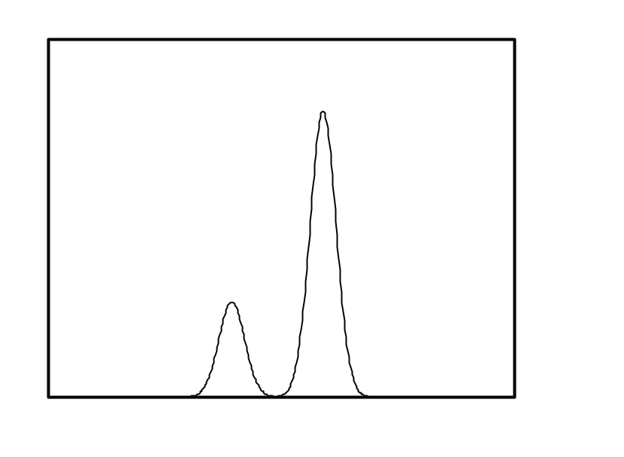


Relaxation labelling
We assume again a bi-modal object/background histogram with maximum greylevel g_{max}
Background
Object

Slide 57
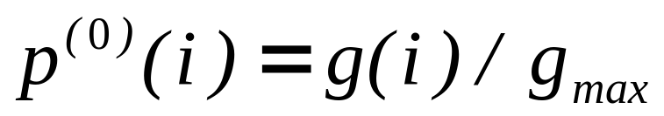
Relaxation labelling
We can initialize the probabilities
Our relaxation algorithm must ‘drive’ the background pixel probabilities p(i) to 1 and the object pixel probabilities to 0

Slide 58
Relaxation labelling
We want to take into account:
  Neighbouring probabilities p(i₁), p(i₂), …… p(i₈)
  The consistency values c_{s} and c_{d}
We would like our algorithm to ‘saturate’ such that p(i)~1
  We can then convert the probabilities to labels by multiplying by 255

Slide 59
Relaxation labelling
We can derive the equation for relaxation labelling by first considering a neighbour i₁ of pixel i
  We would like to evaluate the contribution to the increment in p(i) from i₁
  Let this increment be q(i₁)
    We can evaluate q(i₁) by taking into account the consistencies

Slide 60
Relaxation labelling
We can apply a simple decision rule to determine the contribution to the increment q(i₁) from pixel i₁
  If p(i_{i}) >0.5 the contribution from pixel i₁ increments p(i)
  If p(i_{i}) <0.5 the contribution from pixel i₁ decrements p(i)

Slide 61
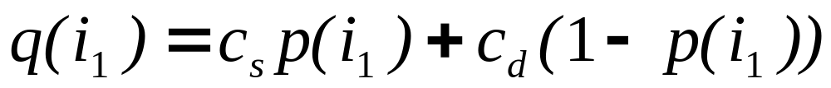
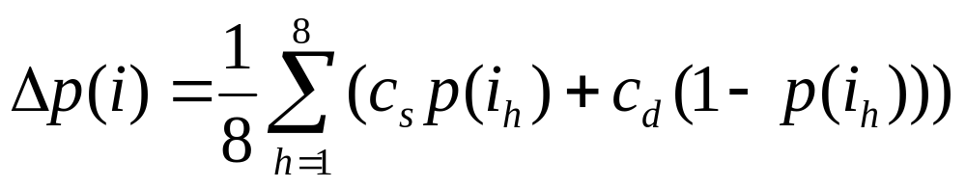
Relaxation labelling
Since c_{s} >0 and c_{d} <0 its easy to see that the following expression for q(i₁) has the right properties
We can now average all the contributions from the 8-neighbours of i to get the total increment to p(i)

Slide 62
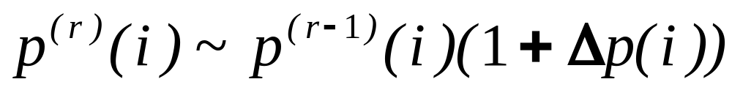
Relaxation labelling
Easy to check that –1<Δp(i)<1 for -1< c_{s} ,c_{d} <1
Can update p(i) as follows
  Ensures that p(i) remains positive
Basic form of the relaxation equation

Slide 63
Relaxation labelling
We need to normalize the probabilities p(i) as they must stay in the range {0..1}
  After every iteration p^{(r)}(i) is rescaled to bring it back into the correct range
Remember our requirement that likely background pixel probabilities are ‘driven’ to 1

Slide 64
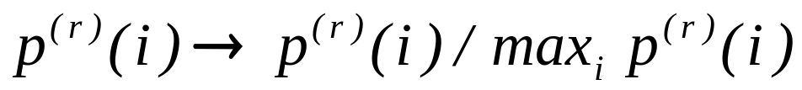
Relaxation labelling
One possible approach is to use a constant normalisation factor
  In the following example, the central background pixel probability may get stuck at 0.9 if max(p(i))=1
0.9
0.9
0.9
0.9
0.9
0.9
0.9
0.9
0.9

Slide 65
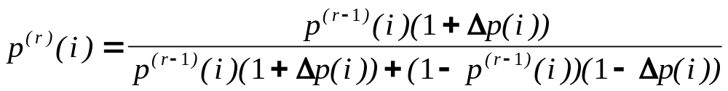
Relaxation labelling
The following normalisation equation has all the right properties
  It can be derived from the general theory of relaxation labelling
  Its easy to check that 0<p^{(r)}(i)<1

Slide 66
Relaxation labelling
We can check to see if this normalisation equation has the correct ‘saturation’ properties
  When p^{(r-1)}(i)=1, p^{(r)}(i)=1
  When p^{(r-1)}(i)=0, p^{(r)}(i)=0
  When p^{(r-1)}(i)=0.9 and Δp(i)=0.9, p^{(r)}(i)=0.994
  When p^{(r-1)}(i)=0.1 and Δp(i)=-0.9, p^{(r)}(i)=0.012
We can see that p(i) converges to 0 or 1

Slide 67

Relaxation labelling
Algorithm performance on the high noise image
  Comparison with thresholding
Relaxation labeling - 20 iterations
High noise circle image
’ Optimum’ threshold

Slide 68

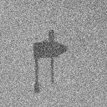

Relaxation labelling
The following is an example of a case where the algorithm has problems due to the thin structure in the clamp image
clamp image
original
clamp image
noise added
segmented clamp image 10 iterations

Slide 69




Relaxation labelling
Applying the algorithm to normal greylevel images we can see a clear separation into light and dark areas
Original
2 iterations
5 iterations
10 iterations

Slide 70

Relaxation labelling
The histogram of each image shows the clear saturation to 0 and 255

Slide 71


The Expectation/Maximization (EM) algorithm
In relaxation labelling we have seen that we are representing the probability that a pixel has a certain label
In general we may imagine that an image comprises L segments (labels)
    Within segment l the pixels (feature vectors) have a probability distribution represented by
    represents the parameters of the data in segment l
      Mean and variance of the greylevels
      Mean vector and covariance matrix of the colours
      Texture parameters

Slide 72








Slide 73


The Expectation/Maximization (EM) algorithm
Once again a chicken and egg problem arises
  If we knew then we could obtain a labelling for each by simply choosing that label which
  maximizes
  If we new the label for each we could obtain by using a simple maximum likelihood estimator
The EM algorithm is designed to deal with this type of problem but it frames it slightly differently
  It regards segmentation as a missing (or incomplete) data estimation problem

Slide 74


The Expectation/Maximization (EM) algorithm
The incomplete data are just the measured pixel greylevels or feature vectors
  We can define a probability distribution of the incomplete data as
The complete data are the measured greylevels or feature vectors plus a mapping function which indicates the labelling of each pixel
  Given the complete data (pixels plus labels) we can easily work out estimates of the parameters
  But from the incomplete data no closed form solution exists

Slide 75
The Expectation/Maximization (EM) algorithm
Once again we resort to an iterative strategy and hope that we get convergence
The algorithm is as follows:
Initialize an estimate of
Repeat
Step 1: (E step)
Obtain an estimate of the labels based on the current parameter estimates
Step 2: (M step)
Update the parameter estimates based on the current labelling
Until Convergence

Slide 76



The Expectation/Maximization (EM) algorithm
A recent approach to applying EM to image segmentation is to assume the image pixels or feature vectors follow a mixture model
  Generally we assume that each component of the mixture model is a Gaussian
  A Gaussian mixture model (GMM)

Slide 77

The Expectation/Maximization (EM) algorithm
Our parameter space for our distribution now includes the mean vectors and covariance matrices for each component in the mixture plus the mixing weights
We choose a Gaussian for each component because the ML estimate of each parameter in the E-step becomes linear

Slide 78



The Expectation/Maximization (EM) algorithm
Define a posterior probability as the probability that pixel j belongs to region l given the value of the feature vector
Using Bayes rule we can write the following equation
This actually is the E-step of our EM algorithm as allows us to assign probabilities to each label at each pixel

Slide 79



The Expectation/Maximization (EM) algorithm
The M step simply updates the parameter estimates using MLL estimation

Slide 80
Conclusion
We have seen several examples of greylevel and colour segmentation methods
  Thresholding
  Clustering
  Relaxation labelling
  EM algorithm
Clustering, relaxation labelling and the EM algorithm are general techniques in computer vision with many applications

